Slide 1


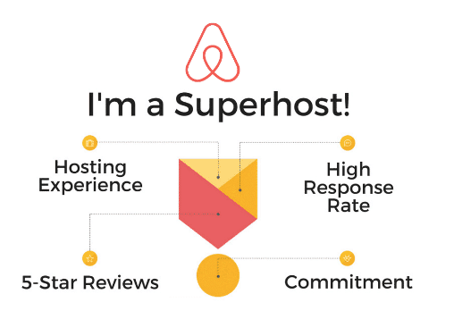
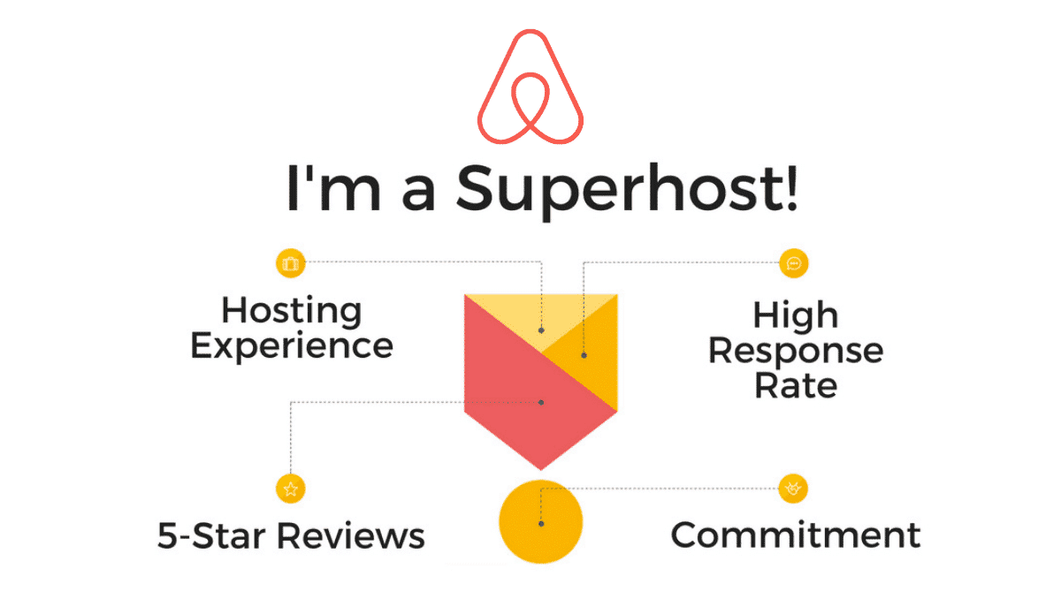
Will we pay more to rent from super hosts?

Slide 2
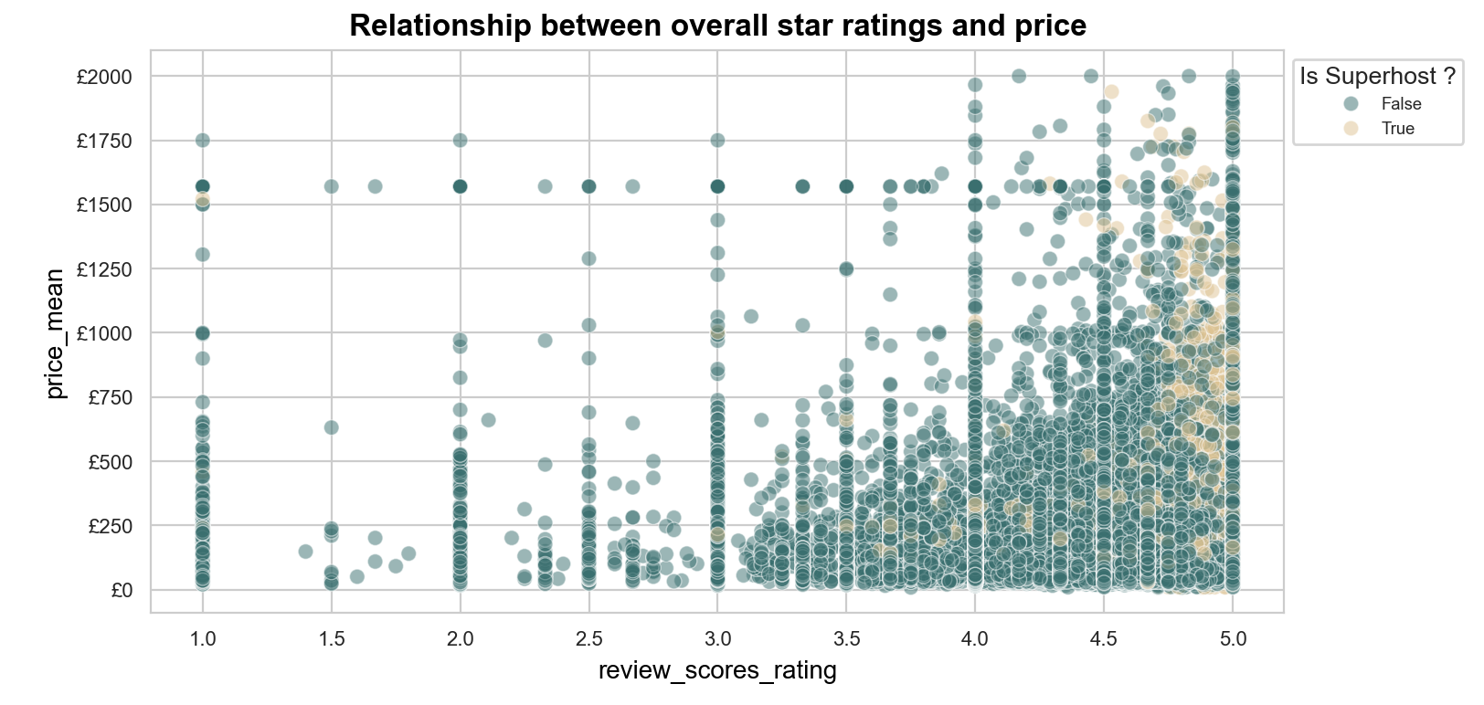
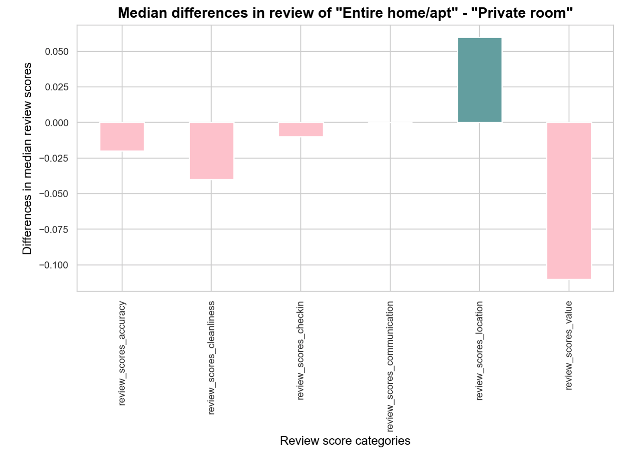
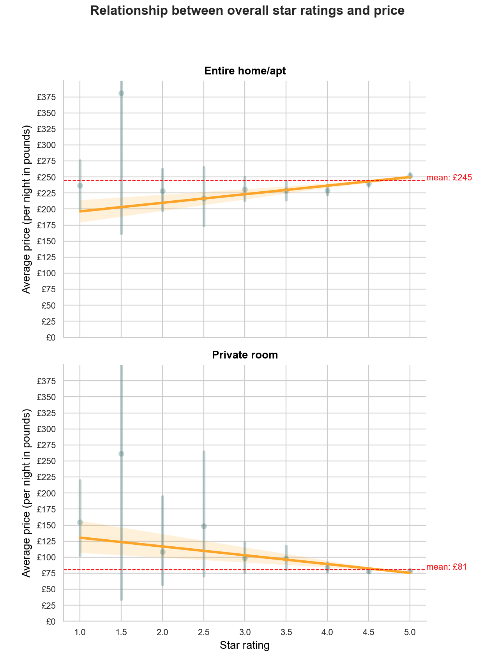

Slide 3
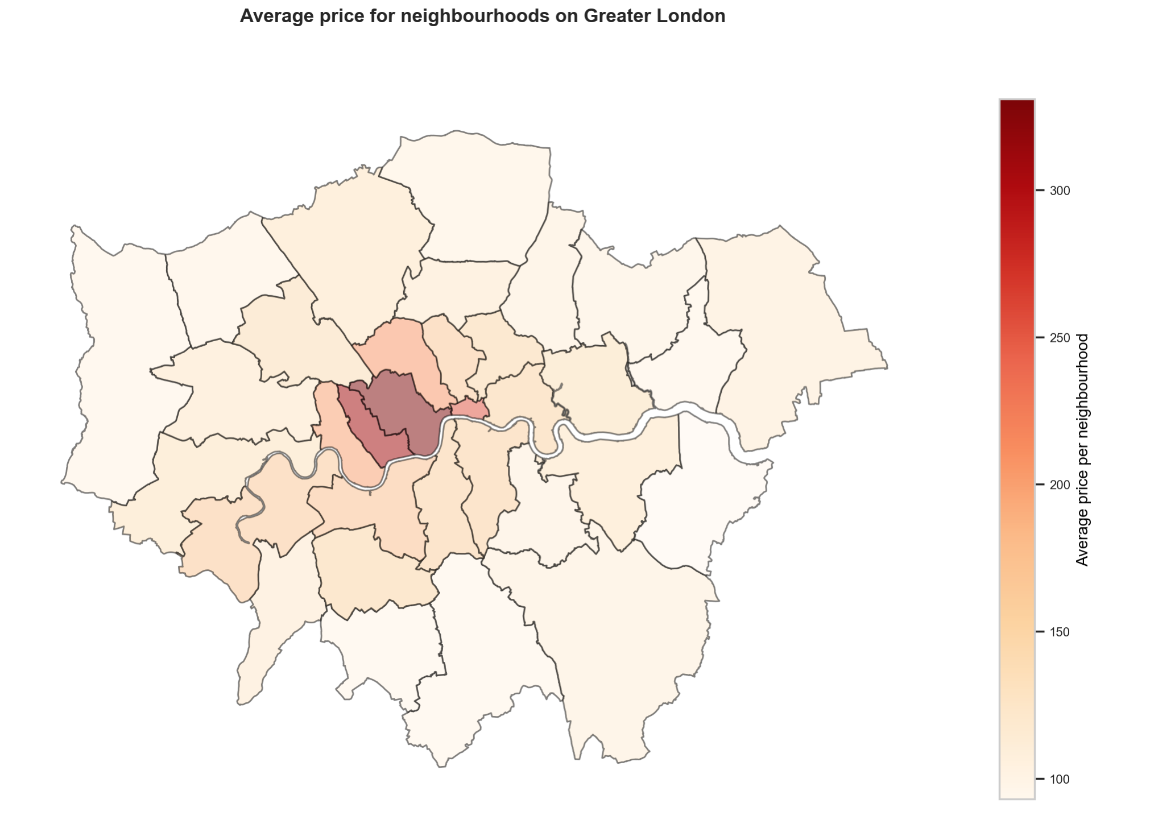
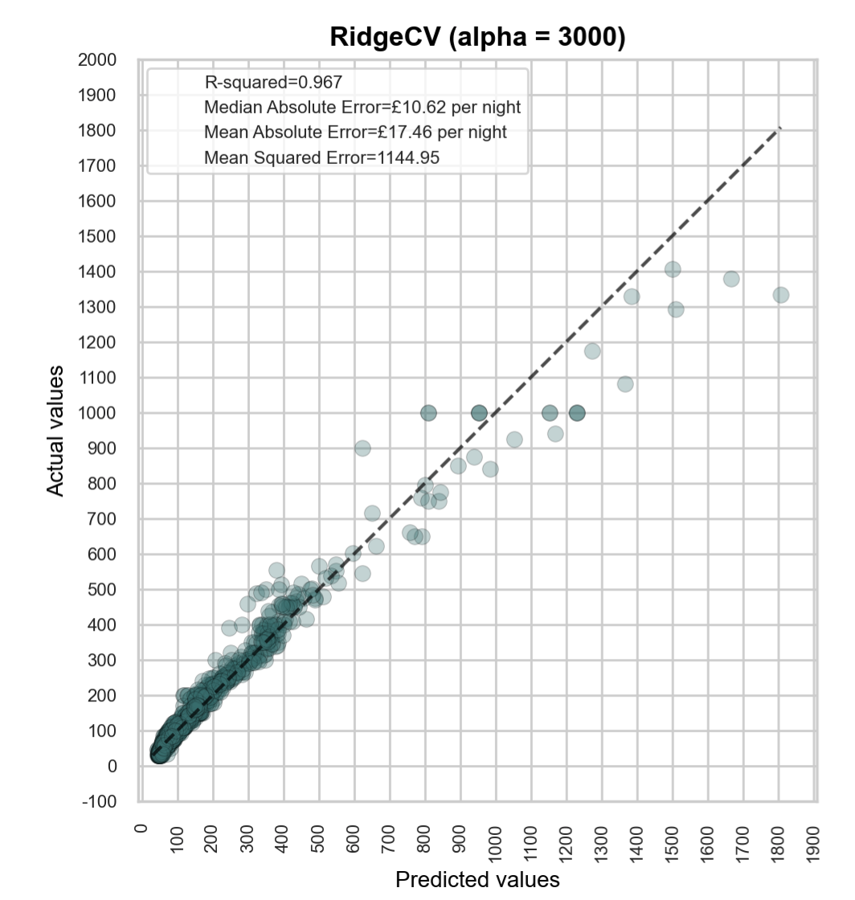
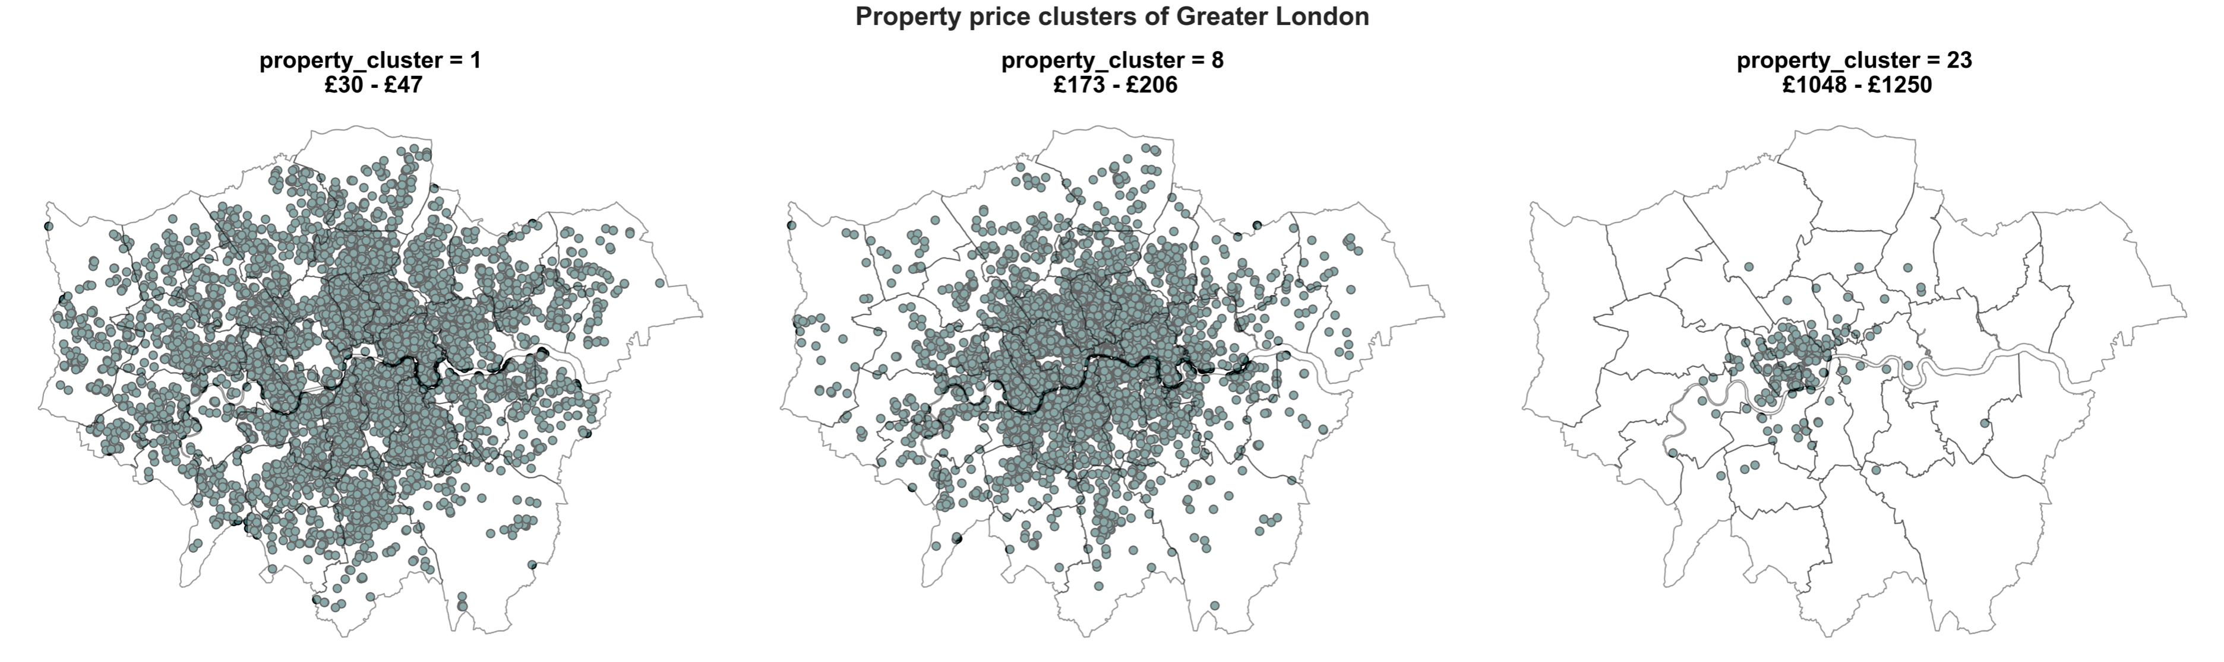
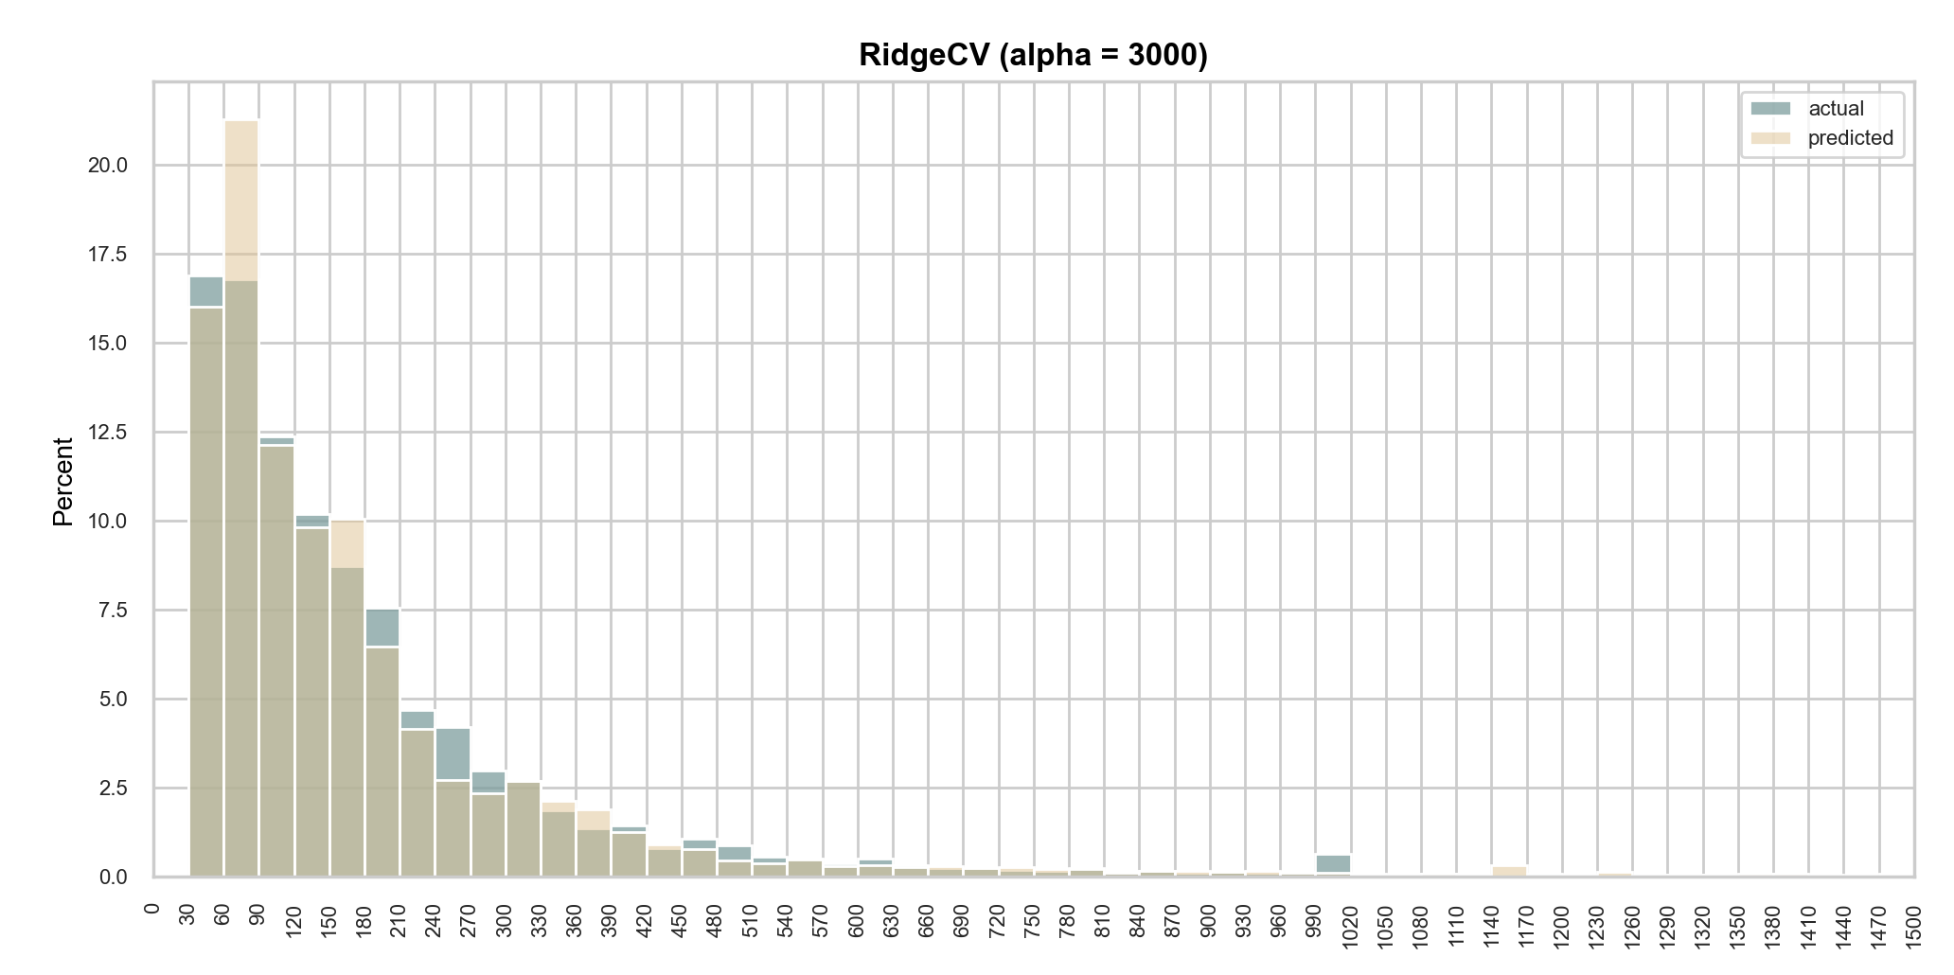

Slide 4
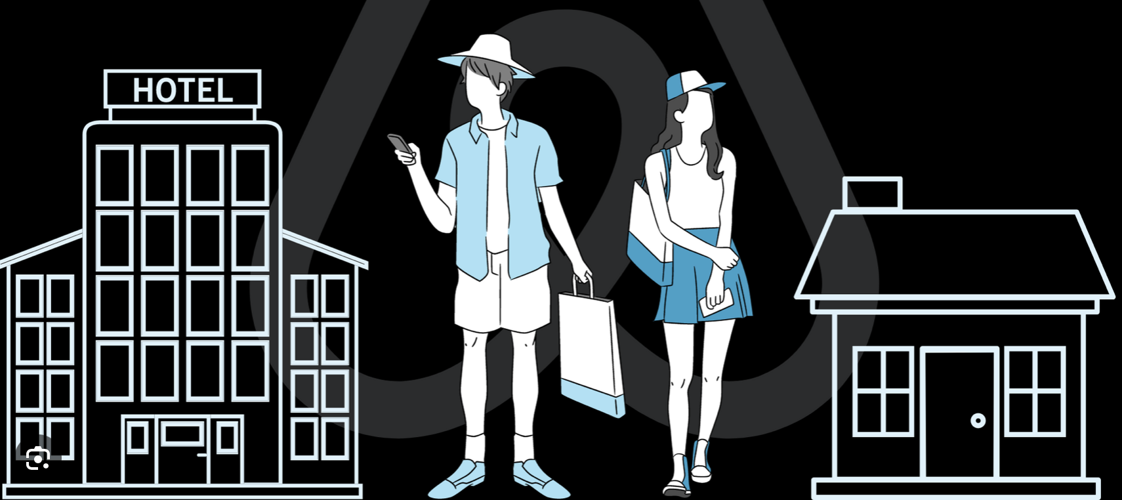
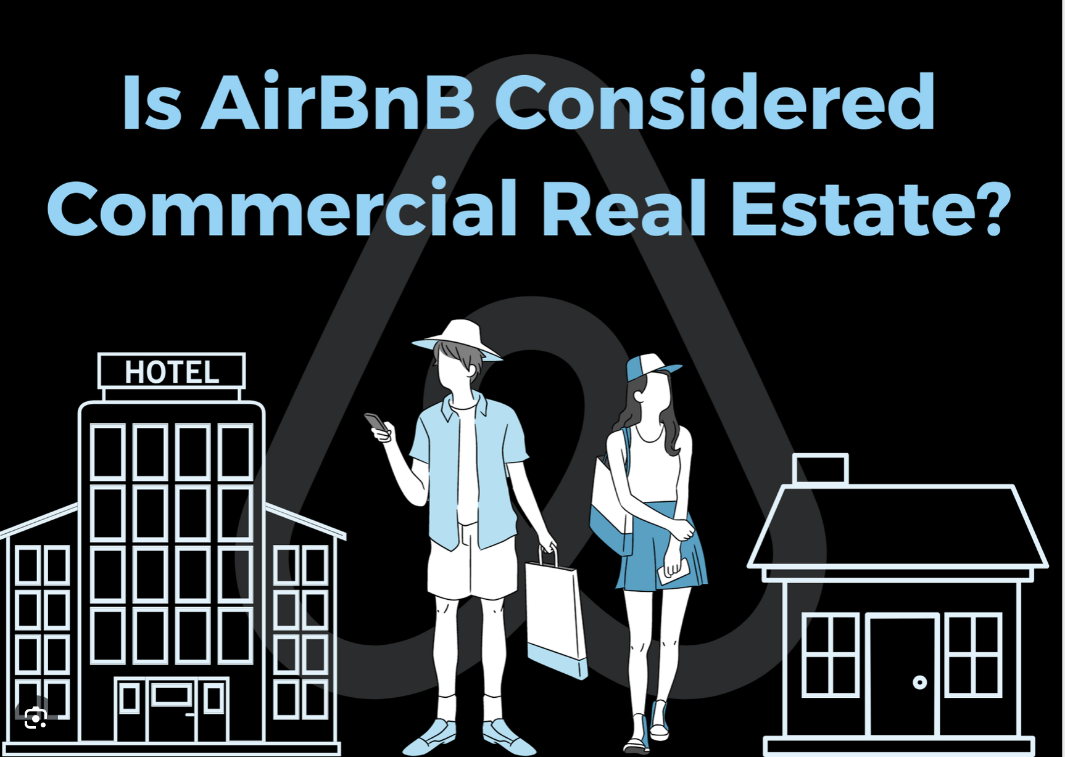




Slide 5

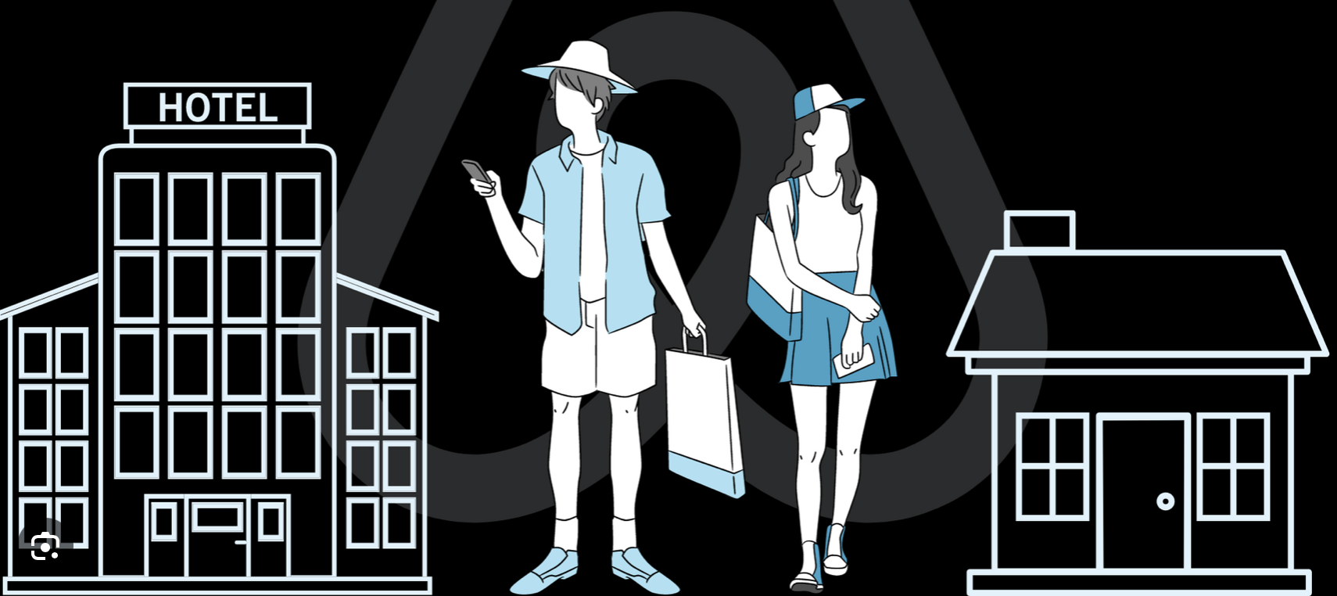

Predicting Airbnb rental prices
What causes price hikes and trends ?
1
Are some hosts running a business?
How does host excellence influence price ?
3
2
What effect does star ratings have on rental price ?

Slide 6
Factors that could cause price hikes and exceptions
1
Are some hosts running a business and if so, do they charge more than individual hosts ?
2
Will we pay more to rent from super hosts?
3
What effect does star ratings have on rental price ?
Will we pay more for a 5-star listing ?
Predicting Airbnb rental prices

Slide 7
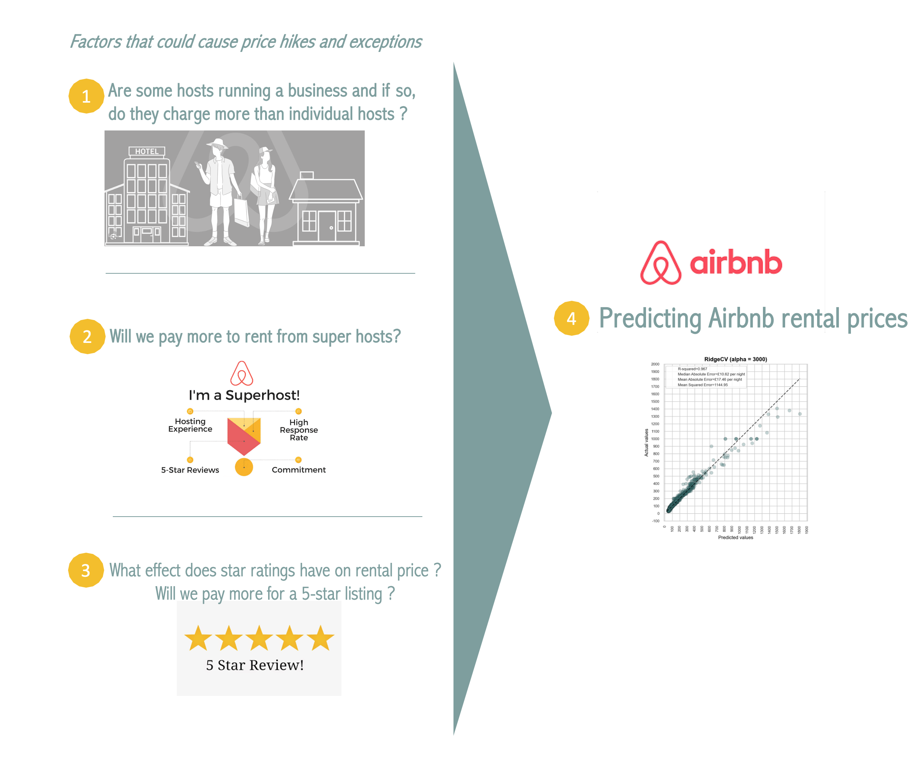
Factors that could cause price hikes and exceptions
1
Are some hosts running a business and if so, do they charge more than individual hosts ?
4
Predicting Airbnb rental prices
2
Will we pay more to rent from super hosts?
3
What effect does star ratings have on rental price ?
Will we pay more for a 5-star listing ?

Slide 8
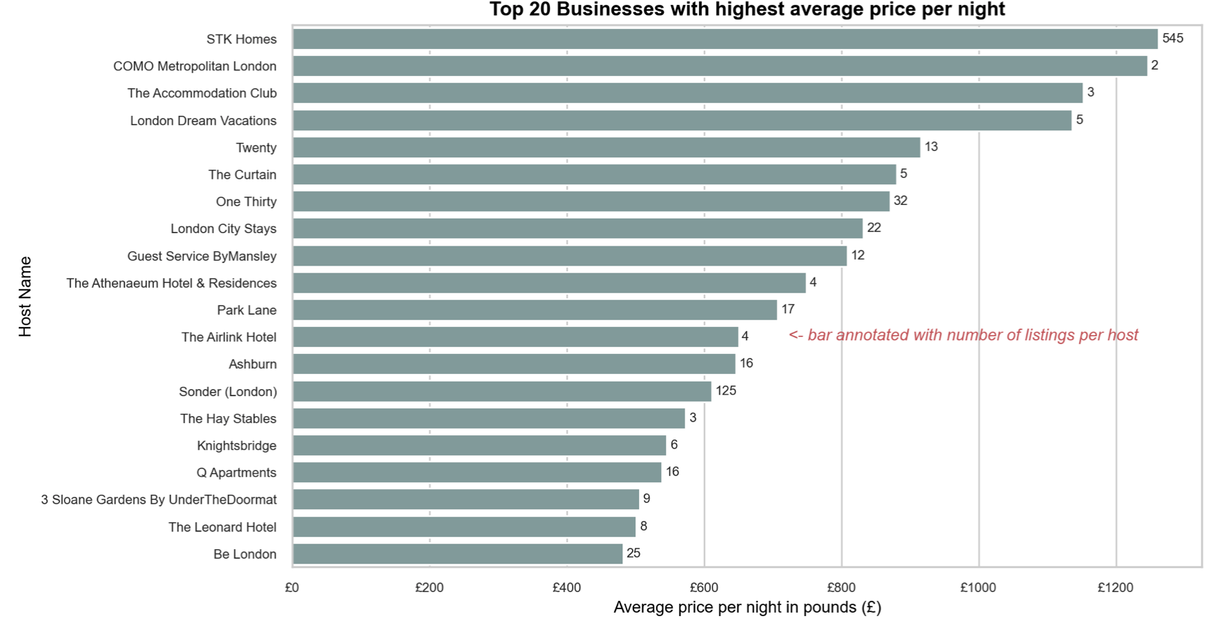
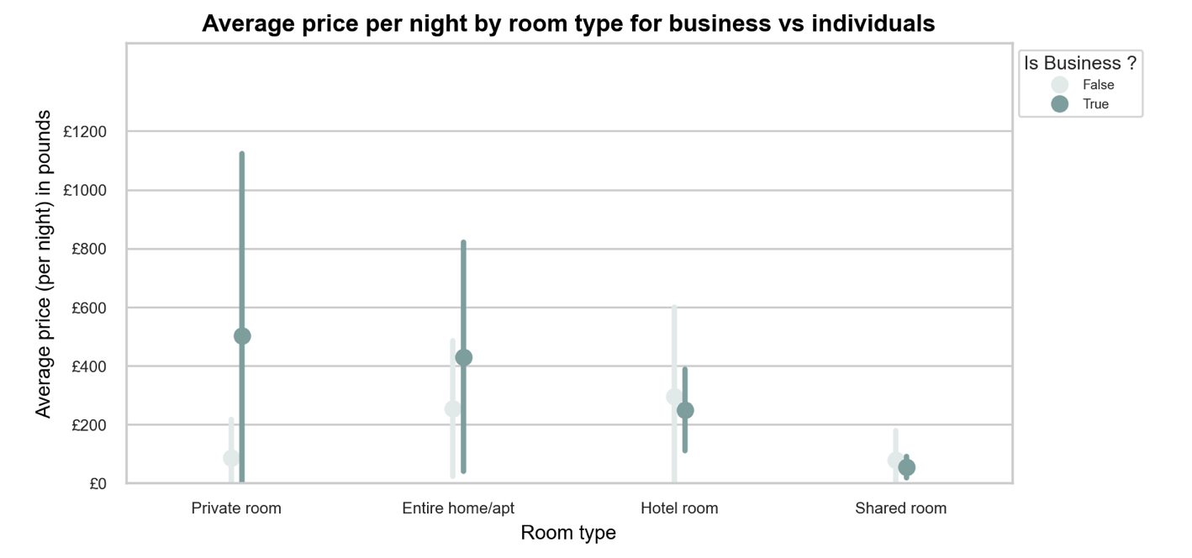
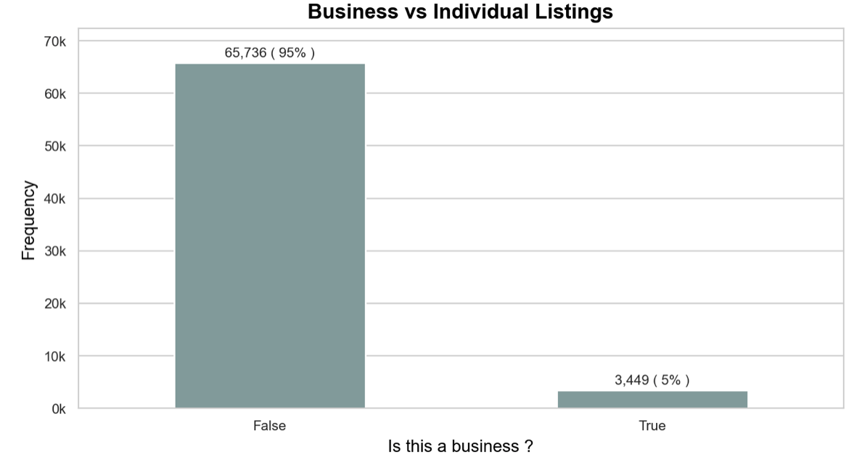
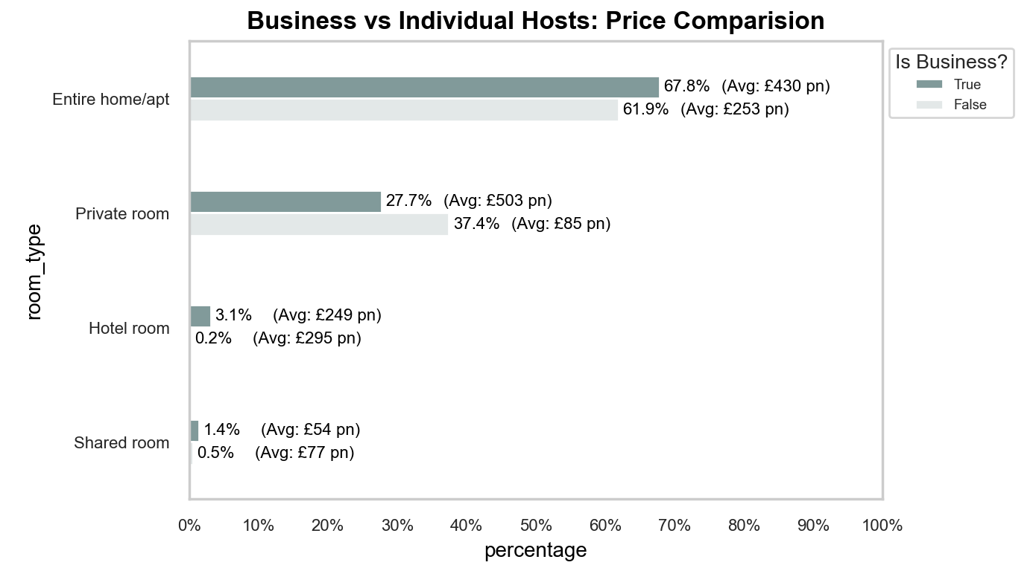

Slide 9
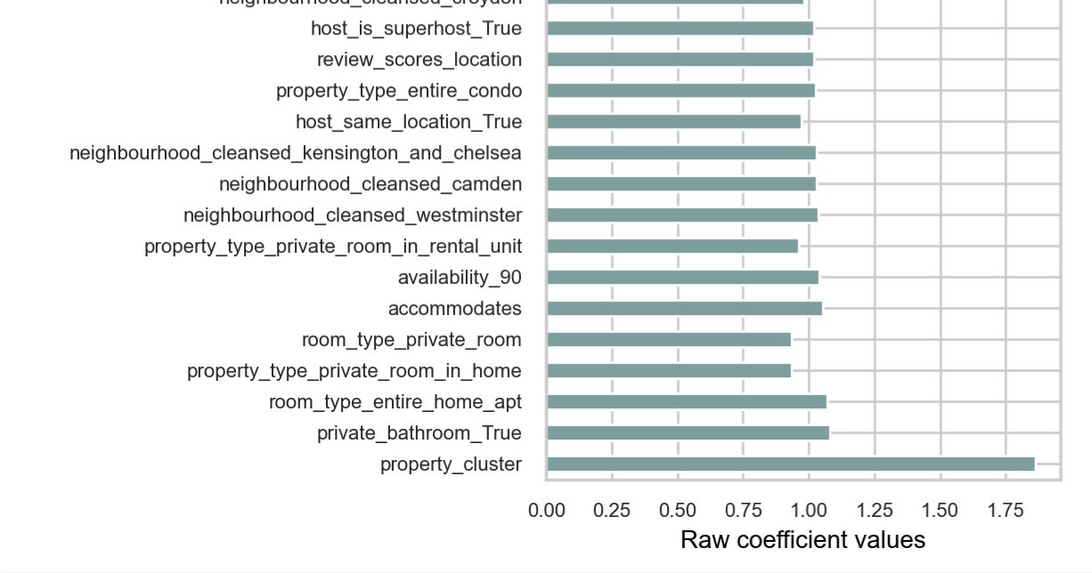
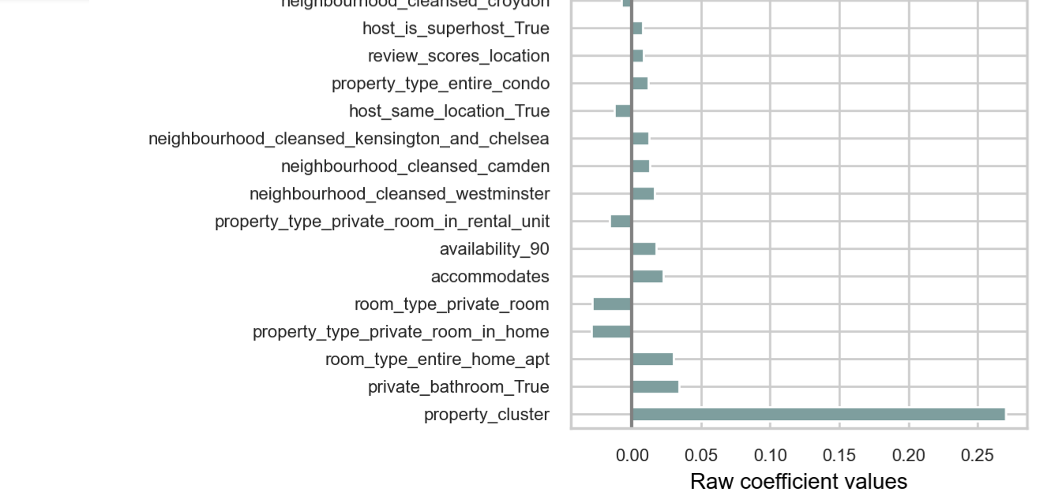

Slide 10
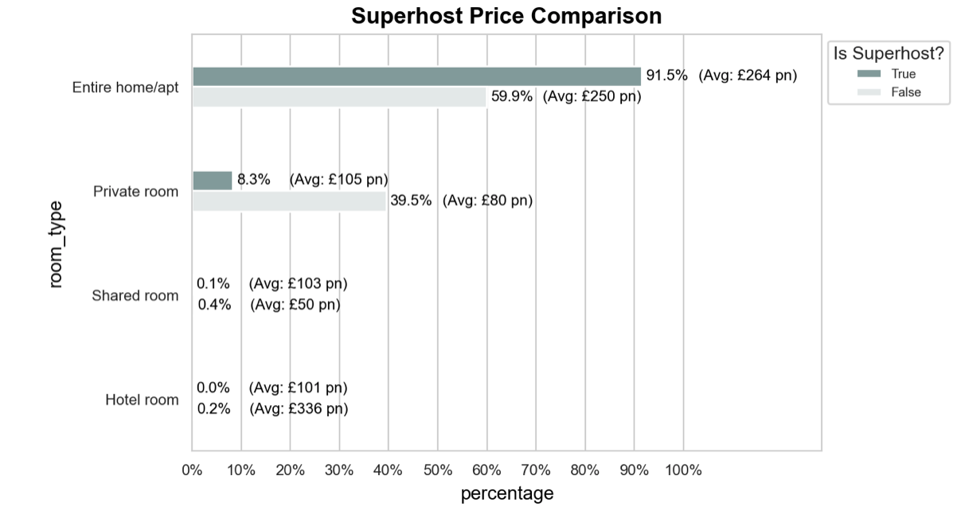

Slide 11
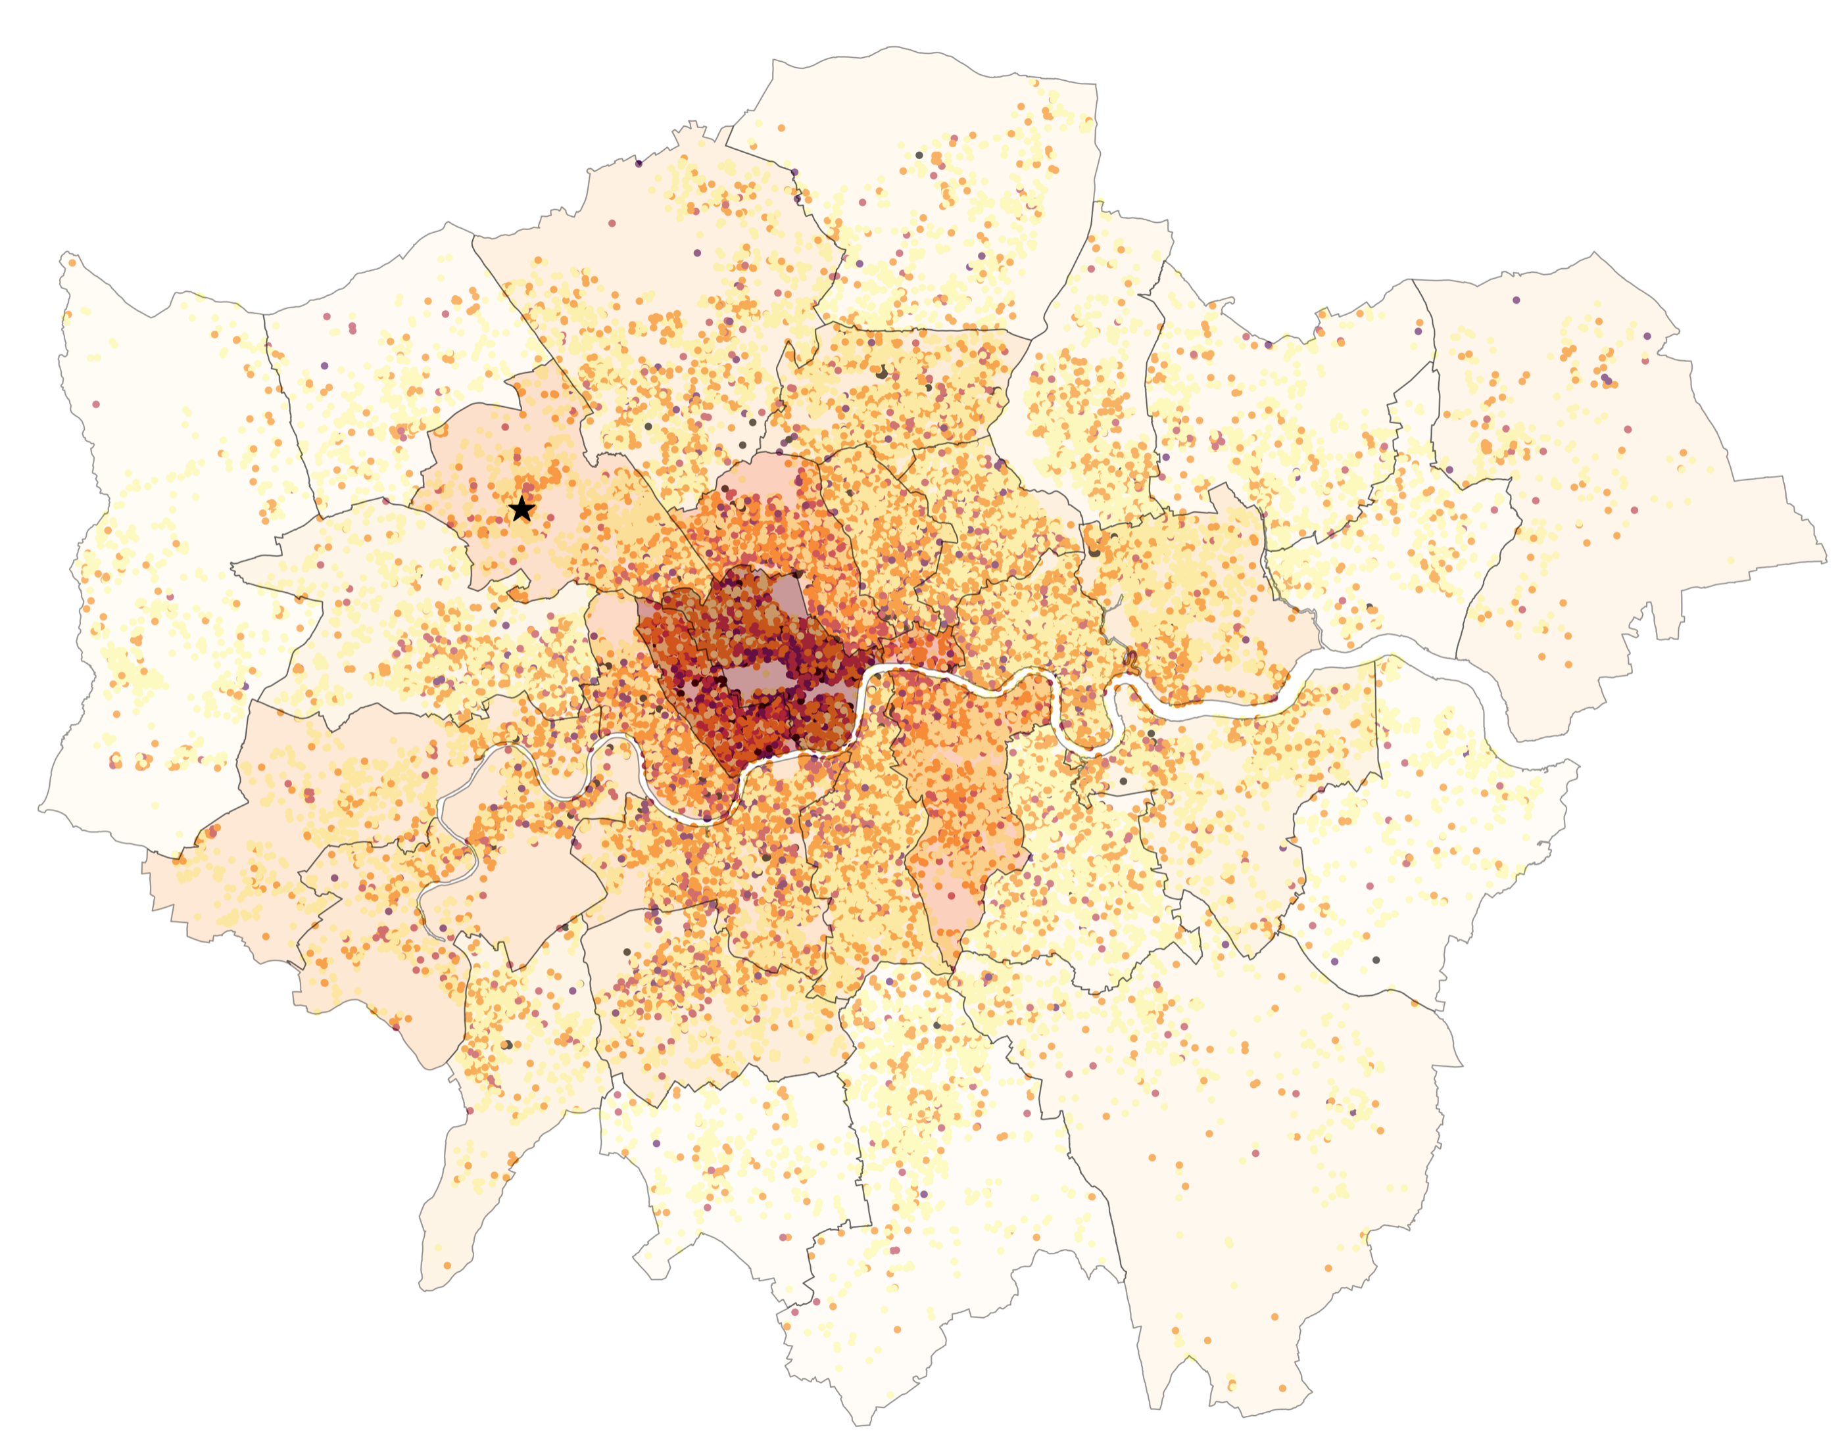
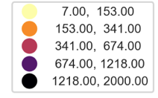

Slide 12
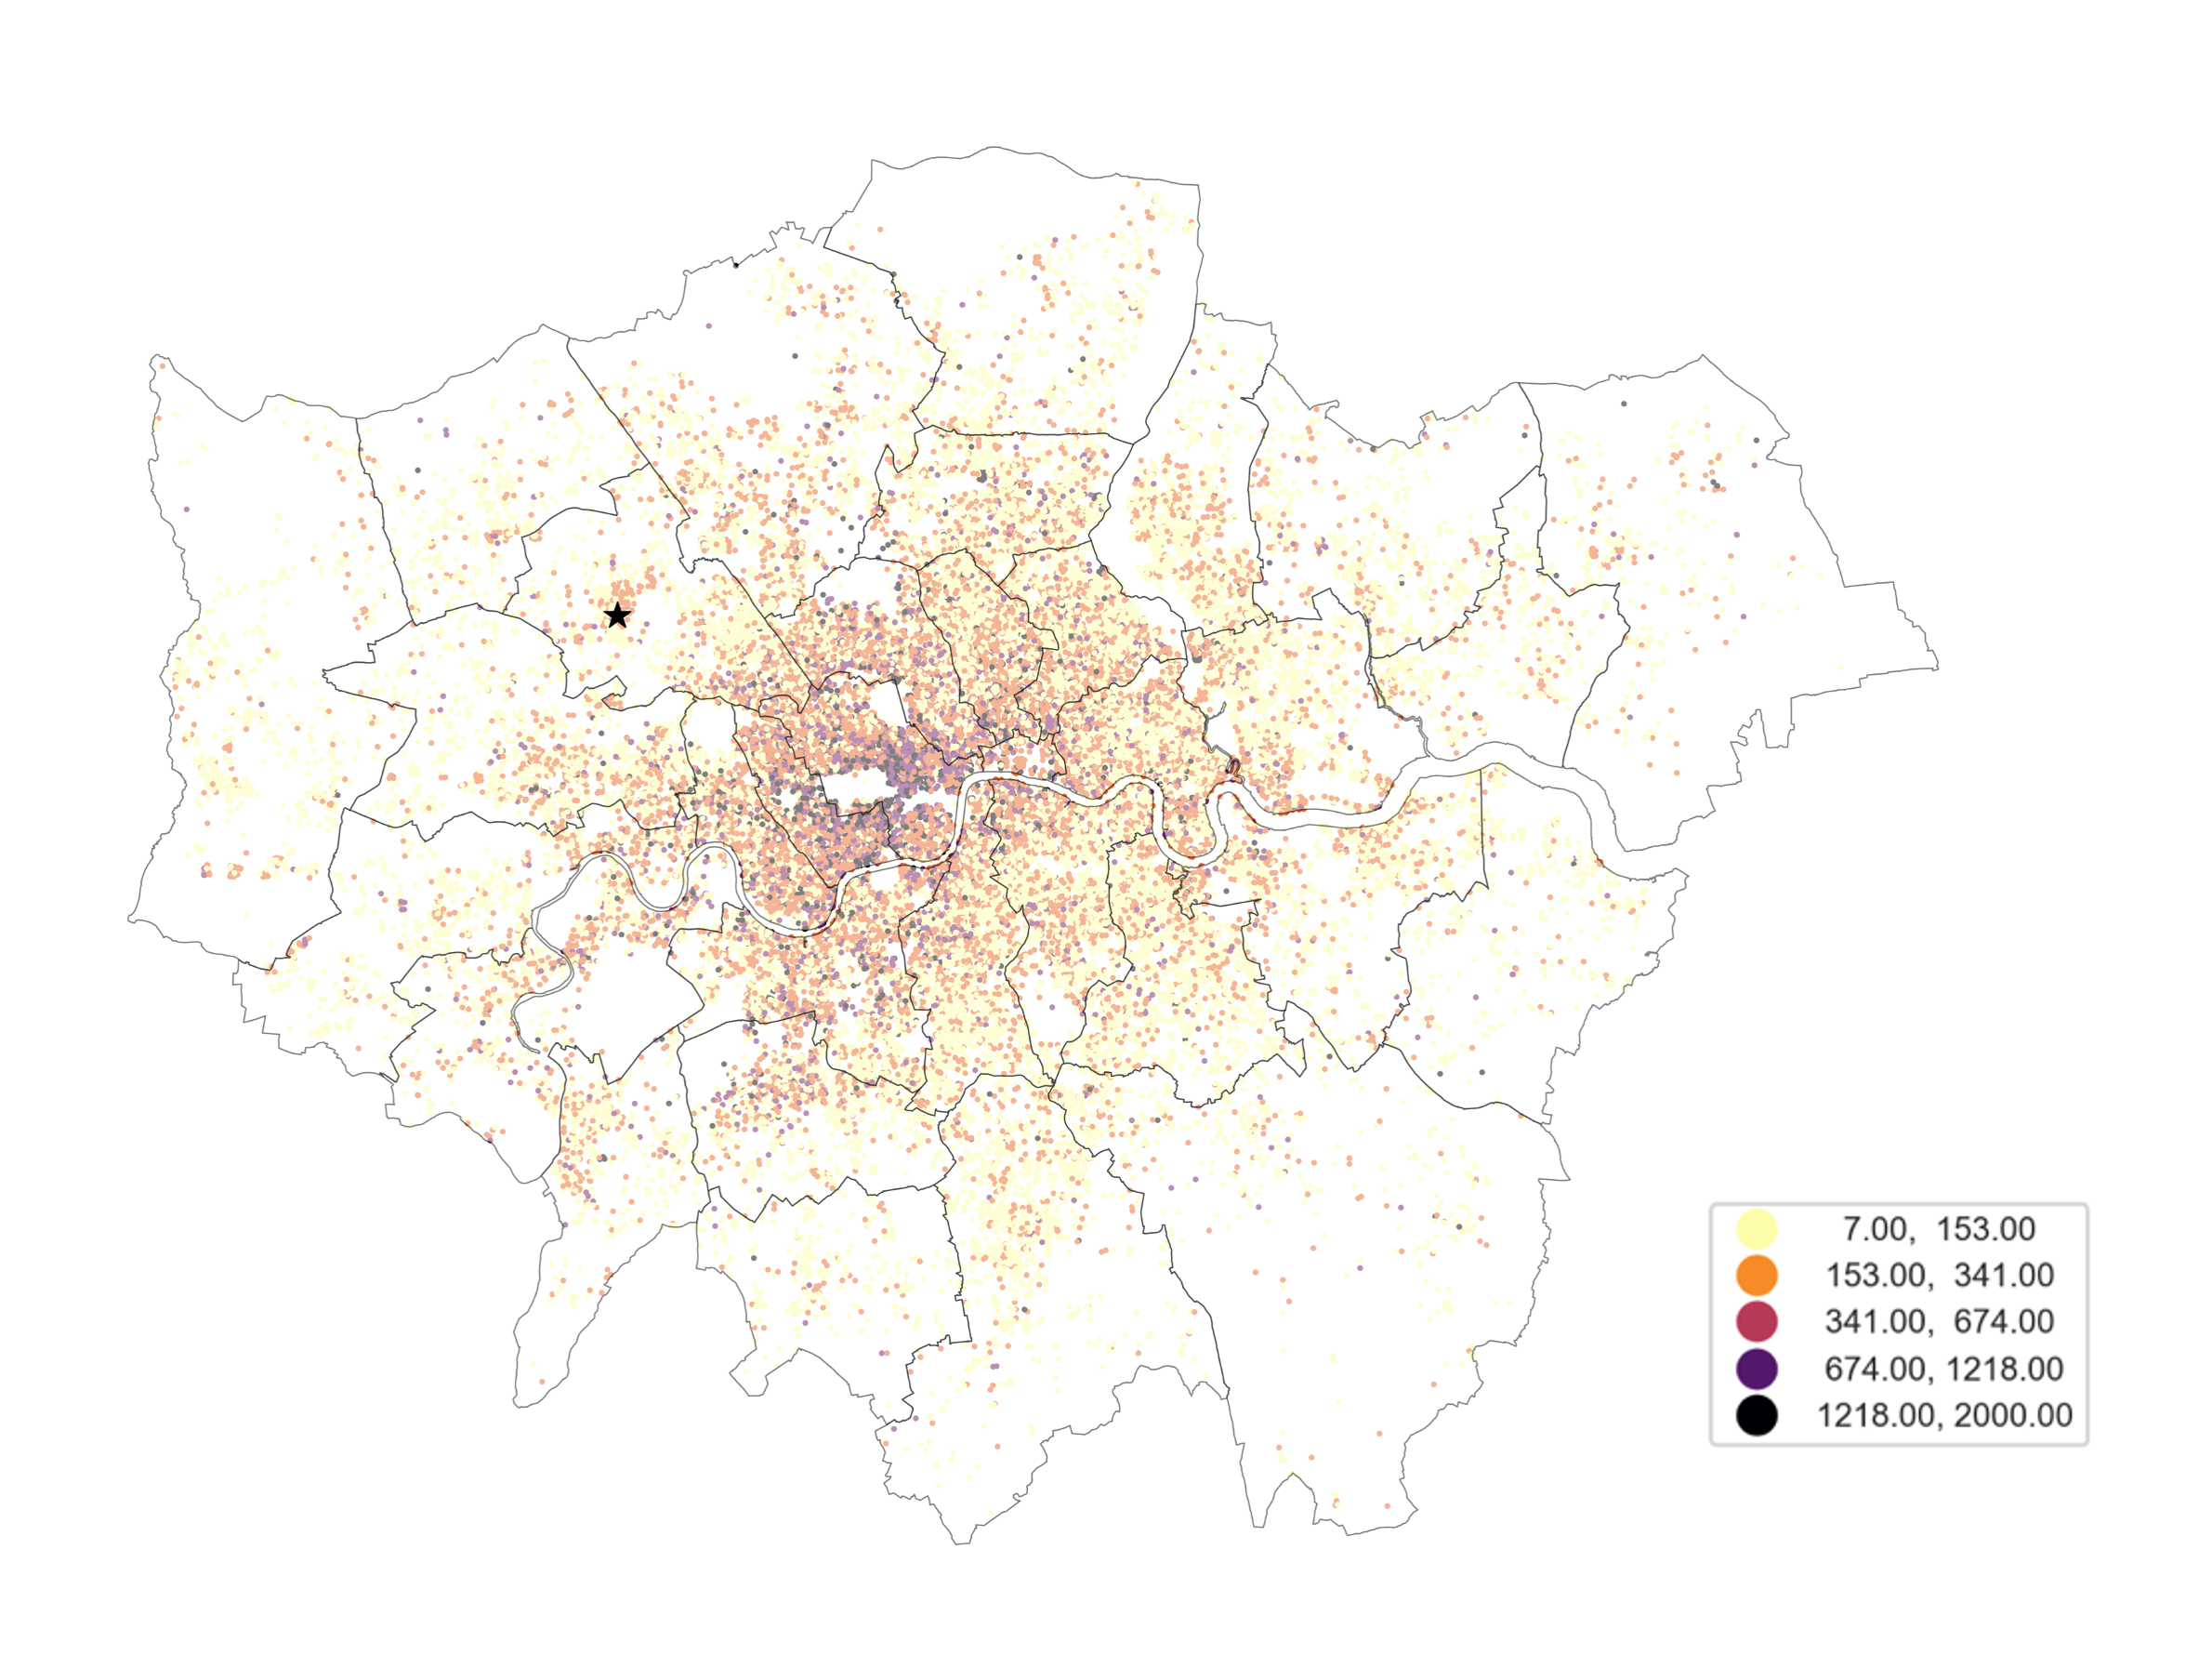
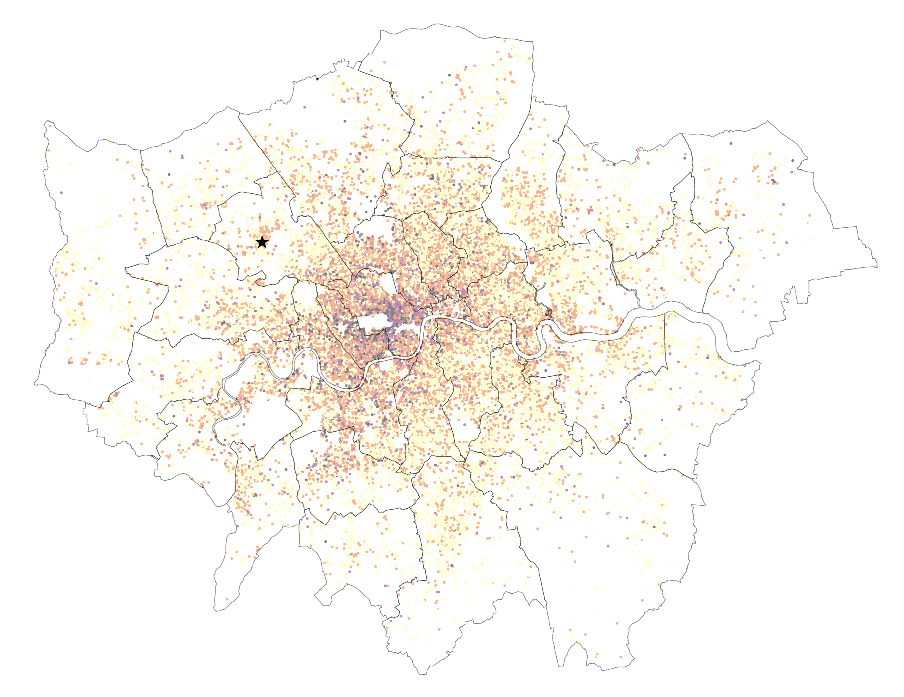

Slide 13




Slide 14

Price
Business
Host Excellence
Star Rating

Slide 15
Price
Business
Host Excellence
Star Rating

Slide 16


Slide 17





7C9E9E

Slide 18








aaa

